Slide 1
Wireless Security
The network administrator must be aware of the security issues when configuring a wireless LAN.
The fact is, RF (radio frequencies) will pass through walls, ceilings, and floors of a building even with low signal power.
Therefore, the assumption should never be made that the wireless data is confined to only the user's area. The network administrator must assume that the wireless data can be received by an unintended user.
In other words, the use of an unsecured wireless LAN is opening a potential threat to network security.

Slide 2
Wireless Security
To address this threat to WLAN security, the network administrator must ensure that the WLAN is protected by firewalls and intrusion detection, and most importantly the network administrator must make sure that the wireless security features are TURNED ON!!!!!

Slide 3
SSID
WLANs use an SSID (service set identifier) to authenticate users, but the problem is that the SSID is broadcast in radio link beacons about 10 times per second.
In WLAN equipment, the beacons are transmitted so that a wireless user can identify an access point to connect to.
The SSID can be turned off so it isn't transmitted with a beacon, but it is still possible for the SSID to be obtained by packet sniffing.

Slide 4
SSID
Disabling SSID broadcasting will make it so that most client devices (such as Windows devices and Mac devices) won't notice that the wireless LAN is present.
This at least keeps “casual snoopers” off the network.

Slide 5
SSID
Enterprise-grade access points implement multiple SSIDs, with each configured SSID having its own VLAN and wireless configuration.
This allows the deployment of a common wireless LAN infrastructure that supports multiple levels of security, which is important for some venues such as airports and hospitals (where there are both public and private users).

Slide 6
IEEE 802.11 supports two ways to authenticate clients: open and sharekey.
Open authentication basically is a null authentication that can enable any client to authenticate to an AP as long as the client knows the correct SSID.
In sharekey authentication, both the client and the access point share a key called a pre-shared key (PSK).
The client sends a shared key authentication request and then a packet of text called a challenge text is sent by the access point to the client with the instruction to encrypt the text and return it to the access point. This requires that wired equivalent privacy (WEP) be turned on.

Slide 7
WEP
WEP is used to encrypt and decrypt wireless data packets.
The exchange and the return of the encrypted text verifies that the client has the proper WEP key and is authorized to be a member of the wireless network.
It is important to note that shared key authentication is extremely vulnerable.
As a result, it's standard practice to avoid the use of shared key authentication.

Slide 8
WEP / WPA-WPA2
It is well-known that WEP is a weak wireless security system.
An improvement with wireless security is provided with WPA and WPA2.
WPA stands for Wi-Fi Protected Access, and it supports the user authentication provided by 802.1x

Slide 9
802.1x
The 802.1x standard enhances wireless security by incorporating authentication of the user.
Cisco Systems uses an 802.1x authentication system called LEAP. In Cisco LEAP, the user must enter a password to access the network.
This means that if the wireless client is being used by an unauthorized user, the password requirement will keep the unauthorized user out of the network.

Slide 10
WPA / EAP
WPA is considered to be a higher level of security for wireless systems.
In the 802.1x system, a user requests access to the wireless network via an access point. The next step is for the user to be authenticated.
At this point, the user can only send EAP messages. EAP is the Extensible Authentication Protocol and is used in both WPA and WPA2 by the client computer and the access point.

Slide 11
The access point sends an EAP message requesting the user's identity.
The user (client computer) returns the identity information that is sent by the access point to an authentication server.
The server will then accept or reject the user's request to join the network.
If the client is authorized, the access point will change the user's (client's) state to authorized.

Slide 12
A Remote Authentication Dial-In User Service (RADIUS) service is sometimes used to provide authentication.
This type of authentication helps prevent unauthorized users from connecting to the network.
Additionally, this authentication helps to keep authorized users from connecting to rogue or unauthorized access points.

Slide 13
Basic Guidelines for Wireless Security
Make sure the wireless security features are turned on.
Use firewalls and intrusion detection on your WLAN.
Improve authentication of the WLAN by incorporating 802.1x features.
Consider using third-party end-to-end encryption software to protect the data that might be intercepted by an unauthorized user.
Whenever possible, use encrypted services such as SSH and Secure FTP.

Slide 14
The bottom line is that the choice of the level of security will be based on multiple factors within the network.
For example, what is the cost benefit ratio of increased security?
How will incorporating or not incorporating increased wireless security affect users?
The network administrator and the overall management will have to make the final decision regarding wireless security before it is installed and the network becomes operational.

Slide 15
Remote Access
This section addresses the technologies used to facilitate dial-in access to a network. This includes an overview of analog, digital, and hybrid techniques used for establishing a remote network connection via the telephone.
The limitations of a modem connection are first examined followed by an overview of the V.92/V.90 standard (hybrid connection).

Slide 16
Remote Access
Next, high speed access is examined using cable modems, and DSL.
This section concludes with the last piece needed for remote access, the Remote Access Server.

Slide 17
Analog Modem Technologies
The voice frequency (analog) channels of the public switched telephone network are used extensively for the transmission of digital data.
Transporting data over analog channels requires that the data be converted to an analog form that can be sent over the bandwidth-limited line voice-grade channels.

Slide 18
Voice Grade Channel
in voice-grade telephone lines, the bandwidth is limited by transformers, carrier systems, and line loading.
Each of these factors contributes to attenuation of all signals below 300 Hz and above 3400 Hz.
While the bandwidth from 300 to 3400 Hz is suitable for voice transmission, it is not appropriate for digital data transmission since the digital pulse contains harmonics (higher frequencies) well outside this range.

Slide 19
MODEM
Transmission of digital data via a phone requires the conversion of the digital signal to fit totally within the 300- to 3400-Hz range.
This conversion is provided by a modem.
MO- Modulator DEM - Demodulator

Slide 20
Modem standards
V.44(V.34) - which is totally analog and supports data rates up to 33.6 Kbps
V.92(V.90) - which is a combination of digital and analog and supports data rates up to 56 Kbps.

Slide 21
Asymmetric operation
The V.92/90 modem connection requires a V.92 or V.90-compatible modem and a service provider who has a digital line service back to the phone company.
The data transfer with V.92/90 is called asymmetric operation because the data-rate connection to the service provider is typically at V.34 speeds
whereas the data rate connection from the service provider is at the V.92/90 speed (56 kpbs).
The difference in the data rates in asymmetric operation is due to the noise introduced by the analog-to-digital conversion process.

Slide 22
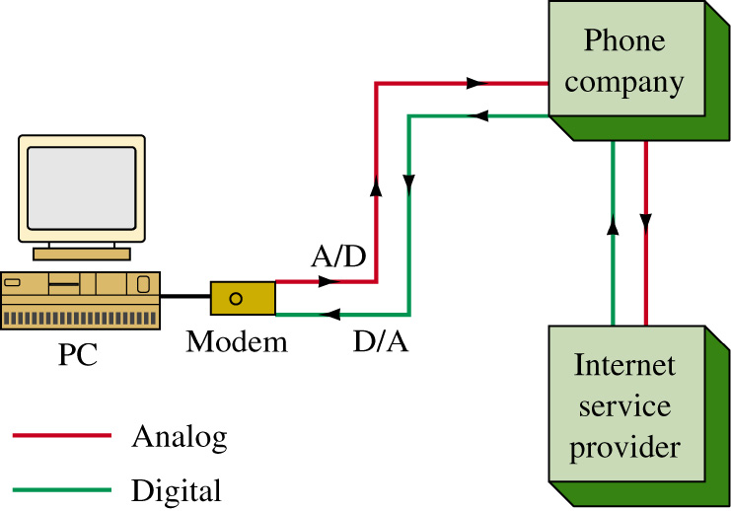
V.92 Modem Connection to the ISP

Slide 23
Cable Modems
Cable modems are identified by the term DOCSIS which stands for Data Over Cable Service Interface Specification. DOCSIS is an international standard that enables high—speed data transfers over the cable system.
Cable modems capitalize on their high-bandwidth network to deliver high-speed, two-way data.
Data rates range from 128 kbps to 10 Mbps upstream (computer to the cable head end)
10 to 30 Mbps downstream (cable head end back to the computer)

Slide 24
Remote Access Server
The Remote Access Server (RAS) is the last piece needed for completing a dial-up connection to the network. The remote access server provides a way for the outside user to gain access to a network.
The connection to a RAS server is typically provided through a telephone line provided by the PSTN (Public Switched Telephone Network). In other words, the basic telephone service. The dial-up connection could also be via cable modem, ISDN or DSL technologies.
Typically uses PPP (Point-to-PointProtocol)

Slide 25
Remote Access Server
The protocol typically used for connecting to a RAS is PPP the Point-to-Point Protocol.
PPP is used for serial interface connections such as that provided by modems. PPP is a full-duplex protocol and is a subset of the HDLC data encapsulation presented in section 8-2.
PPP helps establish the dial-up connection, manages the data exchanges between the user and the RAS, and manages the data packets for delivery over TCP/IP.

Slide 26
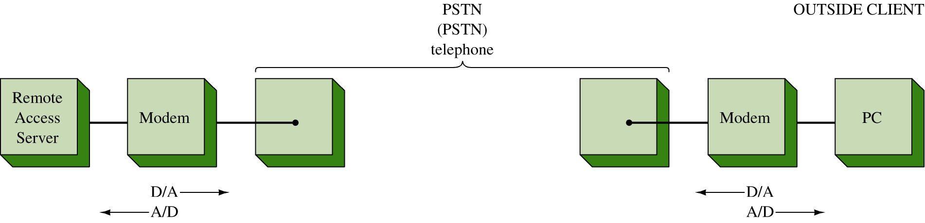
Connecting the Server to the PSTN

Slide 27
Remote Access Server
When the connection to the network is made, a client/server or a peer-to-peer network is created.
A client is a computer connected to the network that uses services from the server.
A peer is a computer that uses and provides resources to the network. In a peer-to-peer network, all computers connected in the network use and provide similar services. The client computer can also function as a server for the network.
In a client/server network the server handles multiple requests from multiple clients for multiple services.

Slide 28
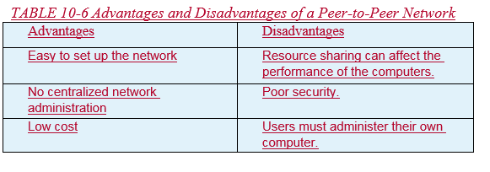
Remote Access Server
It isn't practical to say which network choice, peer-to-peer or client/server, is best for all applications. Both types are used, and it is up to the users and the administrator for the LAN to make the choice.
There are definite advantages and disadvantages for each, as outlined in Tables 10-6 and 10-7.

Slide 29
Introduction
When a network is protected behind the firewall, it is sometimes referred to as a private network. Only computers on the same private network are considered to be trusted.
Access to a private network requires special permission to be granted on the firewall.
Imagine a sales company that has its sales workforce through out the country. The sales people need to access the company’s servers and databases at its headquarters, which is protected behind a firewall.

Slide 30
Introduction
It would be a network administrator’s nightmare to grant individual access through the company’s firewall.
Virtual Private Network (VPN) offers a solution to this problem. As the name implies, VPN is a concept of extending a private or a trusted network over public infrastructure like the Internet.
A VPN accomplishes this by establishing a secure connection between the remote end and the private network, therefore enabling the remote clients to becoming part of the trusted network.

Slide 31
VPN Tunnel
A secure VPN connection between two endpoints is known as a tunnel.
A tunnel is created by an encapsulation technique, which encapsulates the data inside a known protocol that is agreed upon by the two end points.
There are two types of VPNs that are commonly used today. One is a remote access VPN and another is a site-to-site VPN.

Slide 32
VPN Tunnel
A remote access VPN is used to facilitate network access for users in remote office networks or for remote users that travel a lot and need access to the network.
The client usually initiates this type of VPN connection. A site-to-site VPN is used to create a virtual link from one site to the other.
It essentially replaces the traditional WAN type connection used in connecting typical sites. This type of VPN requires network hardware like a router or a firewall to create and maintain the connection.

Slide 33
VPN Tunneling Protocols
One of the original tunneling protocols is the Generic Routing Encapsulation (GRE).
GRE is commonly used as a site-to-site VPN solution because of its simplicity and versatility.
It is the only tunneling protocol that can encapsulate up to 20 different types of protocols.

Slide 34
Point-to-Point Protocol
To better understand remote access VPN, one should at least understand the importance of PPP or Point to Point Protocol.
PPP was the key to the remote access solution for dialup networking.
In those days, people would make a dialup connection to their ISP and establish a PPP session to the Internet.

Slide 35
Point-to-Point Protocol
Even though, authentication is optional for PPP, most implementations of PPP provide user authentication using protocols like PAP or CHAP.
PAP (Password Authentication Protocol) is a simple, clear-text (unencrypted) authentication method
CHAP (Challenge Handshake Authentication Protocol). CHAP is an encrypted authentication method, which uses the MD5 hashing algorithm.
SHA which is the secure hash algorithm required by law for use in certain government applications.

Slide 36
Point-to-Point Protocol
Later on, EAP (Extensible Authentication Protocol) was introduced as another PPP authentication method.
During the PPP authentication phase, the ISP dialup server collects the user authentication data and validates it against an authentication server like a RADIUS server.
RADIUS stands for Remote Authentication Dial-In User Service. RADIUS is an IETF standard protocol.
The RADIUS server supports many different methods of user authentication including PAP, CHAP, and EAP.

Slide 37
VPN Tunneling Protocols
Point-to-Point Tunneling Protocol (PPTP) was developed jointly by Microsoft, 3Com, and Alcatel-Lucent in 1996. It has never been ratified as a standard.
Microsoft was a big advocate of PPTP and made PPTP available as part of Microsoft Windows Dialup Networking.
PPTP was widely used as a remote access solution. PPTP was designed to work in conjunction with a standard Point to Point Protocol (PPP).

Slide 38
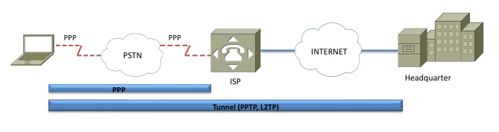
VPN Tunneling Protocols
A PPTP client software would establish a PPP connection to an ISP. Once the connection is established, it will then make the PPTP tunnel over the Internet to the PPTP server.
The PPTP tunnel uses a modified GRE tunnel to carry its encapsulated packet for IP transmission.
PPTP does not have any authentication mechanism, therefore it relies heavily on the underlying PPP authentication.

Slide 39
Layer 2 Forwarding Protocol
L2F was developed by Cisco. L2F was not used widely in the consumer market due to its requirement of L2F hardware.
Unlike PPTP where the VPN client software is installed and initiated from the client, L2F does not require any VPN client software. A L2F connection is intended to done by L2F hardware.
This requires coordination between the ISP and the corporate network. L2F relies on the PPP authentication to be passed on to the corporate authentication server.

Slide 40
Layer 2 Tunneling Protocol
L2TP was created with the intention of merging two incompatibles proprietary tunneling protocols, PPTP and L2F.
L2TP is considered to be an enhancement of the two previous protocols.
L2TP does not require a specific hardware. It can be initiated directly from the client. L2TP Tunnel encapsulation is done on UDP port 1701.
If L2TP is used over an IP network where PPP is not used, the tunnel can be created with its own authentication mechanism.

Slide 41
IPSec
All of the previously discussed tunneling protocols are lacking one important security feature, encryption.
An encryption can guarantee data confidentiality in the tunnel. IPSec or IP Security offers encryption features that the others lack.
IPSec was designed for the purpose of providing a secure end-to-end connection. The VPN can take advantage of IPSec to provide network layer encryption as well as authentication techniques.
IPSec are versatile in that it can be implemented easily as a remote access VPN or as a site-to-site VPN.

Slide 42
IPSec and IPv6
For IPv6, IPSec becomes an even more integral part as it is embedded within the IPv6 packets. There are 2 primary security protocols used by IPSec.
AH (Authentication Header)
ESP (Encapsulating Security Payload).
AH guarantees the authenticity of the IP packets.
ESP provides confidentiality to the data messages (payloads) by ways of encryption.

Slide 43
IPSec Tunnel
Before an IPSec tunnel can be established, there are quite a few security parameters that have to negotiated and agreed upon by both ends. IPSec uses the Internet Key Exchange (IKE) protocol to manage such a process.
IKE is a hybrid protocol that encompasses several key management protocols, most notably ISAKMP (Internet Security Association and Key Management Protocol).
There are 2 negotiation phases that the two network nodes must perform before the IPSec tunnel is complete.

Slide 44
IPSec Tunnel
The IKE Phase 1 - both network nodes authenticate each other and set up an IKE SA (Security Association).
IKE Phase 2 uses the secure channel established in phase 1 to negotiate the unidirectional IPSec SAs, inbound and outbound, to setup the IPSec tunnel.
This is where the parameters for AH and ESP would be negotiated.

Slide 45
Configuring a Remote Access VPN Server
In Windows VPN server - click on Start—Programs—Administrative Tools—Routing and Remote Access.
Right-click the server name and select Configure and Enable Routing and Remote Access. Follow the installation steps and choose the manually configured server option.
Select Virtual Private Network (VPN) Server from the Common Configurations menu.

Slide 46
Configuring a Remote Access VPN Server
The last step in this process is to set the pool of IP addresses to be used by the VPN server.
To do this, right-click the server name and select Properties, click the IP tab and select Static Address Pool—Add—Set range of IP addresses and input the desired IP address range.
The Windows server will issue a default IP address in the 169.x.x.x range if this step is not completed and your client computers will be assigned an IP address that is not valid for your network.

Slide 47
Cisco VPN Client
This section examines setting up an end-to-end encrypted VPN connection using the Cisco VPN Client software.
These connections can be used for both on-site and mobile (remote) users.
The Cisco VPN Client uses IPsec with the option of two encryption modes: tunnel and transport.

Slide 48
Cisco VPN Client
The tunnel mode encrypts the header and the data (payload) for each packet. The transport mode only encrypts the data (payload).
IPsec can be used to encrypt data between various networking devices such as PC to server, PC to router, and router to router.

Slide 49
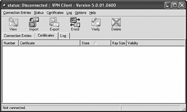
Cisco VPN Client
The first step for setting up the Cisco VPN Client is to install the software on the server that is to be used to establish the VPN connections.
The first window displayed after starting the VPN client is shown. This window indicates that the current status is Disconnected. Click in the Connection Entries tab. This will list the configured connections for establishing the VPN connection.

Slide 50
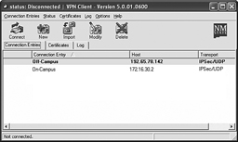

Cisco VPN Client
The available connections for the client are configured when the server software is installed. An example is shown in (a). Select the desired link by double-clicking Conection Entry. The next window displayed will be the initial handshake screen as shown in (b).
(a) (b)

Slide 51
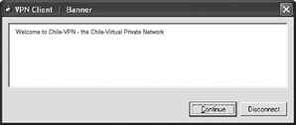
Cisco VPN Client
The next window shows that you have connected to the Virtual Private Network. It says Welcome to Chile-VPN — the Chile-Virtual Private Network.

Slide 52
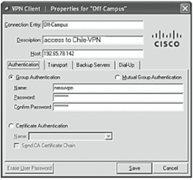
Cisco VPN Client
After the VPN connection has been established you can click the VPN Client icon that should be displayed in the bottom right of your computer screen.

Slide 53
Cisco VPN Client
Select the connection (for example, Chile-VPN). The properties for Chile-VPN will be displayed as shown. This window shows that Group Authentication has been selected. Additionally, the group name and password are entered.

Slide 54
Cisco VPN Client
Select the connection (for example, Chile-VPN). The properties for Chile-VPN will be displayed as shown. This window shows that Group Authentication has been selected. Additionally, the group name and password are entered.

Slide 55
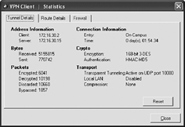
Cisco VPN Client
The next window lists the statistics for the VPN session. The IP addresses for both the VPN server and client are listed.
This screen indicates that a 168-bit 3-DES encryption is being used and the authentication type is HMAC-MD5. 3-DES is called Triple DES.

Slide 56
Cisco VPN Client
HMAC-MD5 (the keyed-Hash Message Authentication Code) is a type of message authentication code (MAC) that is being used with the MD5 cryptographic function.
This window also shows that UDP port 10000 is being used.

Slide 57
Physical Security
This section examines the important and often overlooked task of providing physical security for a networking facility.
The objective of physical security in this case is to protect personnel, data, hardware, and software from any physical actions that could cause any type of loss and/or damage.

Slide 58
Components of Physical Security
There are three significant components of physical security. These are;
Access Control
Surveillance
Testing

Slide 59
Components of Physical Security
Access control – Physical security measures include access control cards, possibly biometric access and access control systems and lockable fencing.

Slide 60
Components of Physical Security
Surveillance – An very important step is making sure that you have cameras monitoring the facility and the perimeter. Notification systems such as sensors for intrusion detection and even smoke detectors and heat sensors should be included.

Slide 61
Components of Physical Security
Testing – The IT facility should have in place a good testing procedure for the physical security system. It is very important step to make sure the facility can quickly detect any intrusions and recover from any disruptions.
Testing procedures should be conducted on a regular basis and updated as needed.

Slide 62
Physical Security
The objective of this section is to make sure that a new IT person has a clear understanding of how to establish and maintain good physical security.

Slide 63
Physical Security
In terms of ideal physical security, the ideal situation is to have a security bubble that surrounds the facility.
While not practical, the meaning is clear, you must provide physical protection with a 360º view of the potential threats.

Slide 64
Physical Security
Having the facility in a security bubble would definitely keep foot traffic to a minimum and physical access will be minimized but this would not be practical.

Slide 65
Physical Security
Obviously, all facilities have points for both ingress (going in) and egress (going out) foot traffic.
How are you going to control access via foot traffic?
Obviously, you will need some form of access control.

Slide 66
Access Control
The purpose of access control hardware is to identify and authenticate someone entering the facility. Authentication can be based on;
Something you know – code, password or PIN.
Something you have – keys, security card or token
Something you are – voice recognition, fingerprint, retina or iris scan

Slide 67
Access Control Hardware
Badge readers – Access badges typically contain a photograph and additional information of the user identifier.
Proximity cards are commonly used badges.

Slide 68
Access Control
By placing the badge or moving the badge close to the badge reader, the card reader will read the identifier information from the card and will search its access control database whether the identifier is allowed access to the premise.

Slide 69
Access Control
Biometric scanners – more sophisticated, higher cost but very effective solution
Since biometrics authorize users based on who they are, it is the most effective way of identifying users.
It is very difficult to fake the fingerprint, voice or retina scans.

Slide 70
Access Control
Access control vestibule (previously known as a mantrap) – typically two interlocking doors requiring the first set of doors to close before the second set of doors is opened.
This is sometimes called a sally port, air lock, or a mantrap. Designed to limit the number of people that can access through particular area at one time.

Slide 71
Access Control
Locking racks - You need to know when racks are accessed and equipment is changed or removed.
In many cases, it is imperative that racks are locked down. Locking racks is important and is a complement to building and access security.

Slide 72
Access Control
Locking cabinets – In the IT world, locking cabinets is another step in physical protection. Having critical equipment and documents locked up provides an additional layer of access control.
While a locked-up room helps to minimize unauthorized access to IT equipment, locking cabinets provides another layer of protection.

Slide 73
Access Control
Detection Methods
Even though a person gains access to the facility, a security surveillance should still be enforced.
This provides real-time monitoring of people, who are inside the facility, and keeping track of their locations. Some of the widely used detection methods are:

Slide 74
Access Control
Surveillance cameras – One of the most fundamental and long-time used security method since the day of CCTV (Closed Circuit Television).

Slide 75
Access Control
Motion detection – These devices detect a change in the position of an object as it relates to its surroundings.
The detection is made possible by mechanical or electronic methods.

Slide 76
Access Control
Security in any organization will incorporate multiple layers of access control. This can be any of the following;
1. Perimeter fencing
2. Video monitoring
3. Building access control using badges and proximity
(prox) cards
4. Man traps
5. Biometric scanning (fingers and retina)
6. Locked access to equipment and documentation

Slide 77
Physical Access Security
what to do to an unused equipment?
equipment typically contains configuration and information that are proprietary to the organization, it cannot be just be thrown away.
It must follow the asset disposal policy of the organization.

Slide 78
Asset Disposal
a tech savvy person can recover your personal information from electronic devices that has been disposed of
it is extremely important that all devices be sanitized before being disposed.
To sanitize a device is the same a wiping all information from a device.

Slide 79
Internet of Things (IoT)
These are smart devices that connect to the businesses network as well as the Internet.
Their flexibility makes it easy to install and connect to your network however it is imperative that the user can make sure that external access (hacker) can be prevented.

Slide 80
Smart Devices
IP Security Cameras
Smart Lockers
Smart Speakers
Smart Doorbells

